Slide 1
SALES, INVENTORY AND
RETAILER ANALYSIS
By
Gopalakrishnan Kumar
File created on: 7/12/2023 5:03:54 AM

Slide 2
Aim and Objectives
To understand the sales numbers of a multi-national retail company and to make them grow by analyzing the stock, price, number of items sold and quality rating for various categories and for various products, retailed by various vendors and to find the sales trends.
To gauge and execute suitable sales techniques, to scale up the sales numbers.
To analyze and evaluate the inventory status for various categories, subcategories, and items.
To carry out meticulous exploration of vendor sales and inventory stocks, which will enable the management to formulate schemes to improvise sales in low profit periods and confirm that the inventory has enough stock to meet the customer requirements.
Methodology Adopted – Creation of Various Dashboards:
Dashboard 1 :Inventory Performance Dashboard.
Dashboard 2 :Retailer Analysis Dashboard

Slide 3
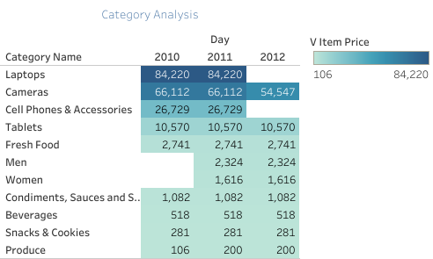
CATEGORICAL ANALYSIS

Slide 4
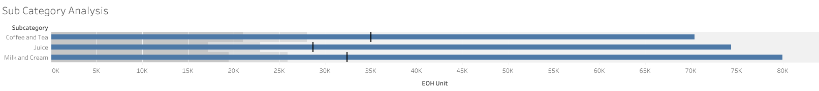
SUB-CATEGORICAL ANALYSIS

Slide 5
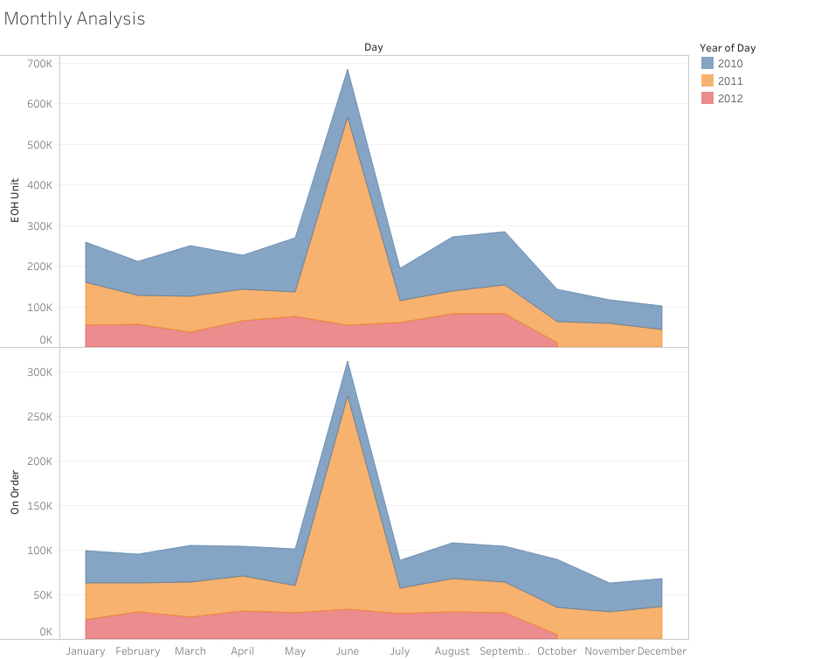
MONTHLY ANALYSIS

Slide 6
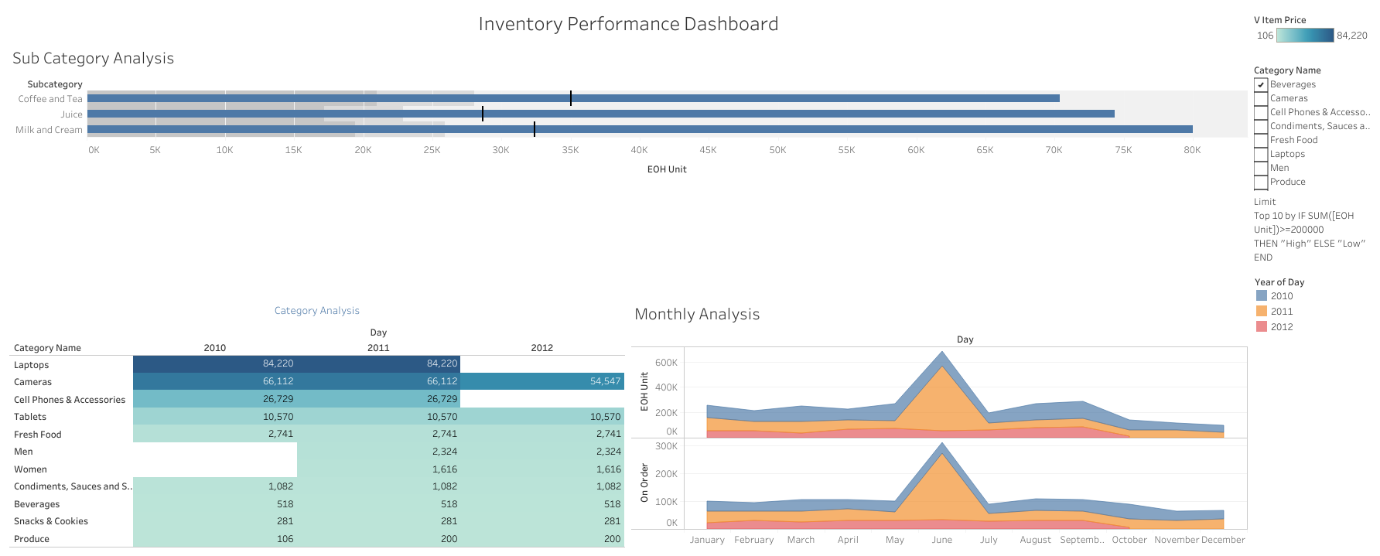
INVENTORY PERFORMANCE
DASHBOARD

Slide 7
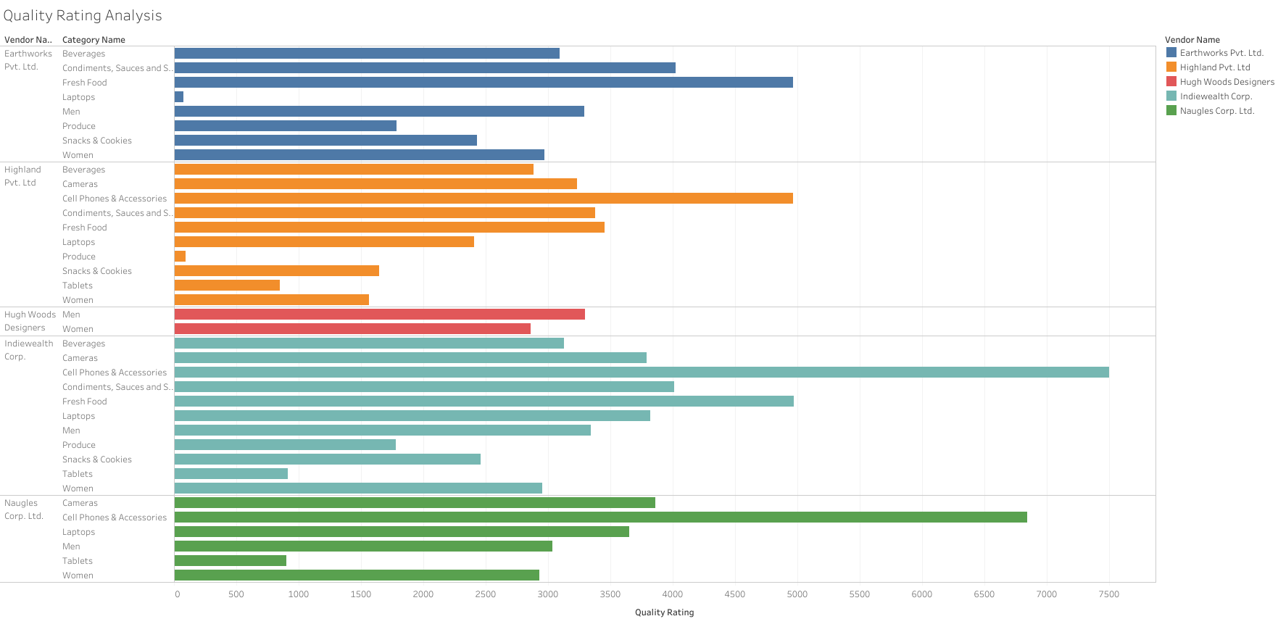
QUALITY RATING ANALYSIS

Slide 8
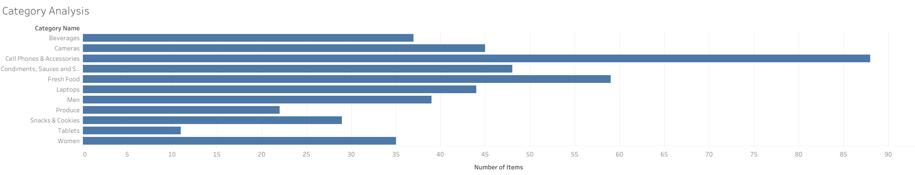
CATEGORICAL ANLYSIS

Slide 9
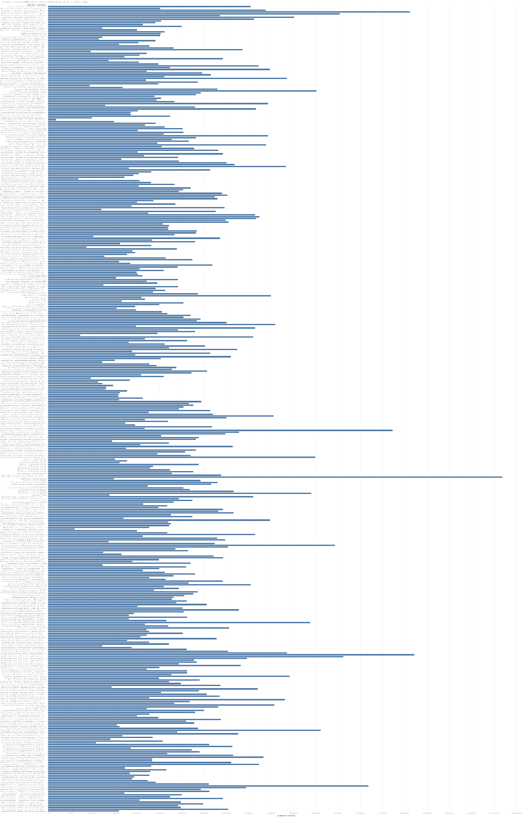
Top and Bottom Products View

Slide 10
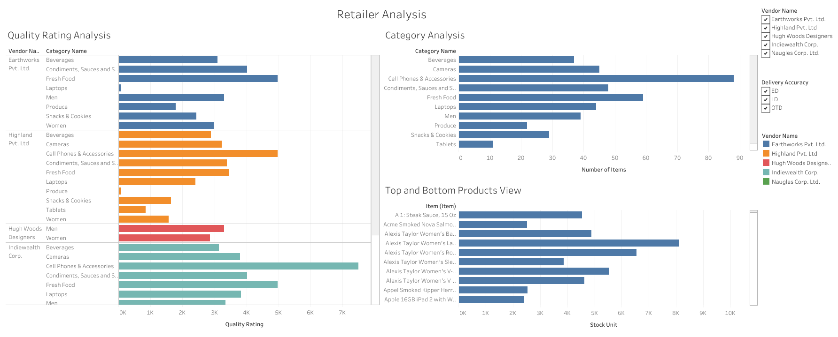
Retailer Analysis Dashboard

Slide 11
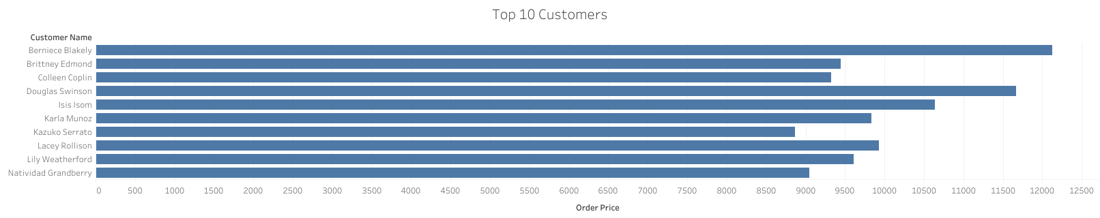
Top 10 Customers

Slide 12
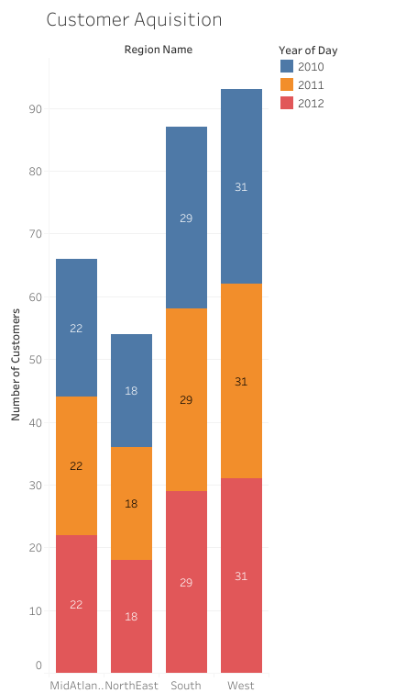
Customer Acquisition

Slide 13
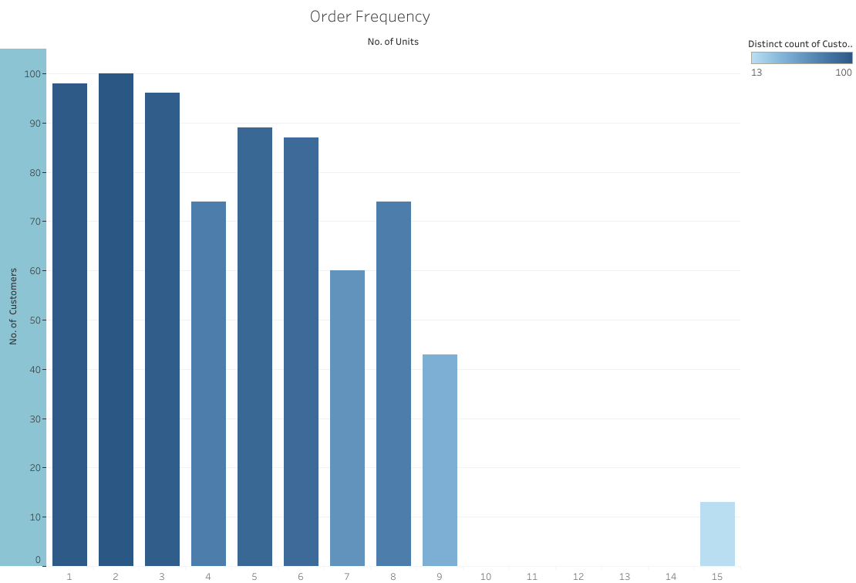
Order Frequency

